Slide 1
Howto – Windows 10 Subsystem for Linux Winver: 1607, 1703, 1709, 1803
Sudhansu Sekhar Sutar

Slide 2
Contents
Windows Subsystems
Windows NT historical subsystems
Windows Services for UNIX (SFU)
OSS Cygwin and MinGW
Windows Subsystem for Linux (WSL)
WSL Command Line
Enable Windows Subsystem for Linux
Enable WSL from Windows Terminal
Enable WSL from Windows Desktop
Install WSL Default Linux distro
Install default Linux distro
Run bash and check version
Manage WSL Instance using LxRun
Install WSL Linux distro Offline
Install Linux distro offline
Manage WSL Instance using LxRunOffline Tool
Install WSL Linux distro from Windows Store
Install Linux distro from Windows Store
Manually Download Windows Store Distro APPX
Manage WSL Instance using wslconfig
Develop and Test Linux Application on WSL
Install GCC on WSL
Compiling Hello World Sample
Develop Linux Application using Visual Studio
Install/Uninstall SSH on WSL
Configuring SSH for Remote Debug
Install Visual C++ for Linux Development Extension
Creating a Linux Development Project
Connecting to WSL for remote compilation and debugging
Develop .Net Core Application on WSL
Install .Net Core SDK on WSL
Create HelloWorld Sample App
References

Slide 3
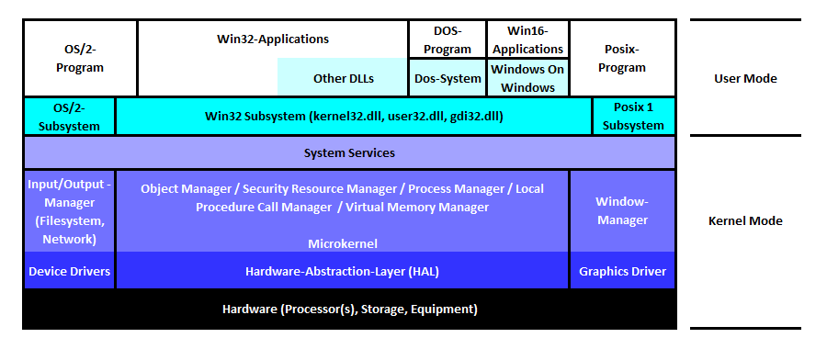
Windows NT historical subsystems

Slide 4
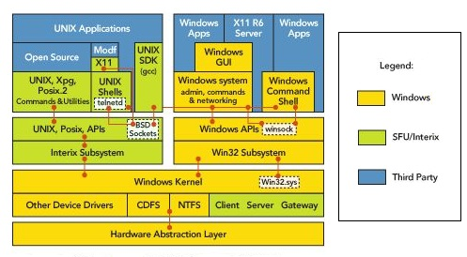
Windows Services for UNIX

Slide 5
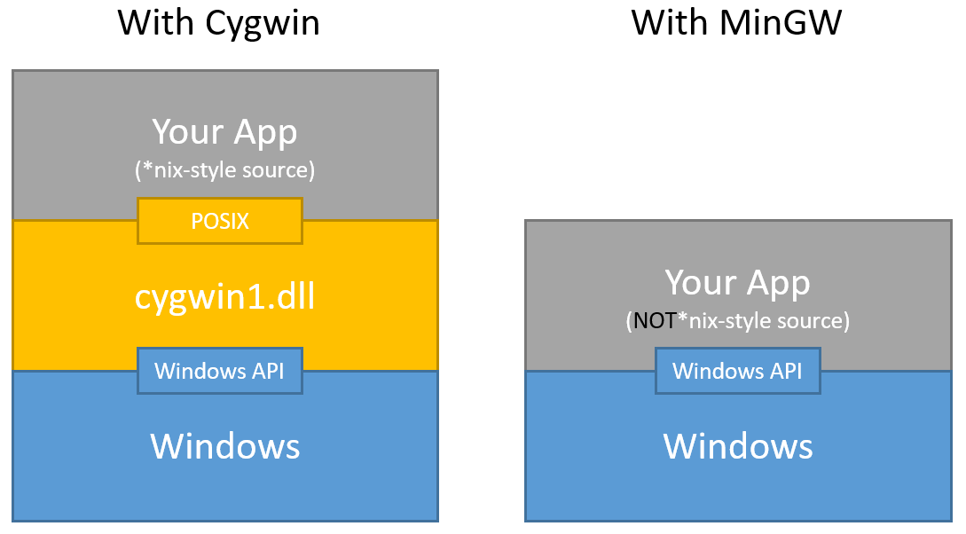
OSS Cygwin and MinGW

Slide 6
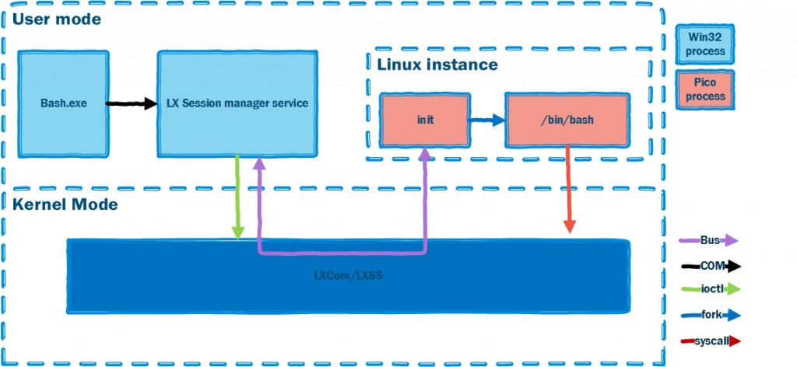
Windows Subsystem for Linux

Slide 7
WSL Command Line
Command | Use | 1607 | 1703 | 1709 | 1803
bash.exe | Used to start a bash shell. | Y | Y | Y | Y
LxRun.exe | Used to install and manage WSL default distro (Ubuntu). | Y | Y | Y
WslConfig.exe | Used to administrate multiple WSL distro. |  |  | Y | Y
wsl.exe | LxRun.exe + WslConfig.exe + bash.exe |  |  |  | Y

Slide 8
Enable WSL from Windows Terminal
1. Enable Developer Mode
This step required only for Winver 1607, 1703
2. Enable WSL
cmd.exe
>Dism /online /Enable-Feature /All /FeatureName:Microsoft-Windows-Subsystem-Linux
Or
powershell.exe
>Enable-WindowsOptionalFeature -Online -FeatureName Microsoft-Windows-Subsystem-Linux

Slide 9
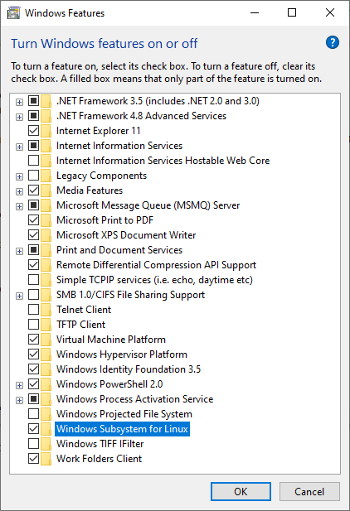
Enable WSL from Windows Desktop
1. Enable Developer Mode
This step required only for Winver 1607, 1703
2. Run
OptionalFeatures.exe
3. Select
Windows Subsystem for Linux

Slide 10
Install default Linux distro
From Windows Terminal run below command
>LxRun.exe /install
LxRun.exe program download and install the following Ubuntu distro.
Winver: 1607 #Ubuntu 14.04
https://go.microsoft.com/fwlink/?LinkID=730581
https://go.microsoft.com/fwlink/?LinkId=747853
Winver: 1703, and 1709 #Ubuntu 16.04
https://go.microsoft.com/fwlink/?LinkID=827586
https://go.microsoft.com/fwlink/?LinkId=747853

Slide 11
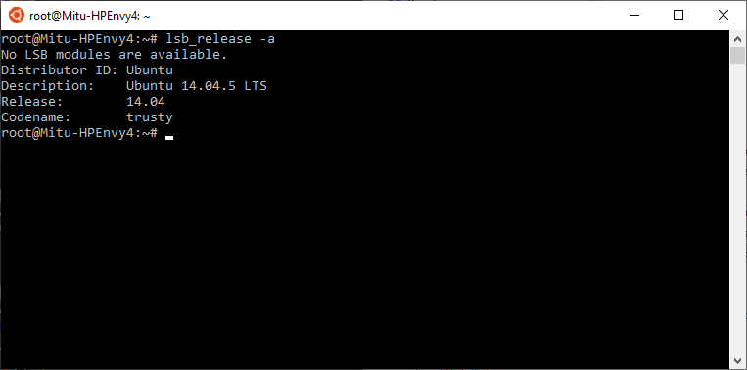
Run bash and check version >bash –c “lsb_release –a”

Slide 12
Manage WSL Instance using LxRun
Command | Description
lxrun | The lxrun command is used to manage the WSL instance.
lxrun /install | Starts the download and install process. /y may be added to bypass all prompts. The confirmation prompt is automatically accepted and the default user is set to root.
lxrun /uninstall | Uninstalls and deletes the Ubuntu image. By default this does not remove the user's Ubuntu home directory. /y may be added to automatically accept the confirmation prompt /full uninstalls and deletes the user's Ubuntu home directory
lxrun /setdefaultuser <userName> | Sets the default Bash on Ubuntu user. Will prompt for a password if the specified user does not exist. For more information visit: https://aka.ms/wslusers. /y Bypasses prompting for the password. The user will be created without a password.
lxrun /update | Updates the subsystem's package index

Slide 13
Install Linux Distro offline
1. Download Ubuntu Cloud Image
https://wsldownload.azureedge.net/14.04.5.3-server-cloudimg-amd64-root.tar.gz
https://wsldownload.azureedge.net/16.04.2-server-cloudimg-amd64-root.tar.gz
https://wsldownload.azureedge.net/ubuntu.ico
Alternative Ubuntu Cloud Image Location: http://cloud-images.ubuntu.com/
More Distro Image Location: https://github.com/DDoSolitary/LxRunOffline/wiki
2. Download LxRunOffline Tool
https://github.com/DDoSolitary/LxRunOffline/releases/download/
3. Install from Windows Terminal
>LxRunOffline i -n Ubuntu-14.04 -d C:\Linux\Ubuntu-14.04 -f 14.04.5.3-server-cloudimg-amd64-root.tar.gz -s
>LxRunOffline i -n Ubuntu-16.04 -d C:\Linux\Ubuntu-16.04 -f 16.04.2-server-cloudimg-amd64-root.tar.gz -s

Slide 14
Manage WSL Instance using LxRunOffline Tool
Option | Description
l, list | List all installed distributions.
gd, get-default | Get the default distribution, which is used by bash.exe.
sd, set-default | Set the default distribution, which is used by bash.exe.
i, install | Install a new distribution.
ui, uninstall | Uninstall a distribution.
rg, register | Register an existing installation directory.
ur, unregister | Unregister a distribution but not delete the installation directory.
m, move | Move a distribution to a new directory.
d, duplicate | Duplicate an existing distribution in a new directory.
e, export | Export a distribution's filesystem to a .tar.gz file, which can be imported by the "install" command.
r, run | Run a command in a distribution.
di, get-dir | Get the installation directory of a distribution.
gv, get-version | Get the filesystem version of a distribution.
ge, get-env | Get the default environment variables of a distribution.
se, set-env | Set the default environment variables of a distribution.
ae, add-env | Add to the default environment variables of a distribution.
re, remove-env | Remove from the default environment variables of a distribution.
gu, get-uid | Get the UID of the default user of a distribution.
su, set-uid | Set the UID of the default user of a distribution.
gk, get-kernelcmd | Get the default kernel command line of a distribution.
sk, set-kernelcmd | Set the default kernel command line of a distribution.
gf, get-flags | Get some flags of a distribution. See https://docs.microsoft.com/en-us/previous-versions/windows/desktop/api/wslapi/ne-wslapi-wsl_distribution_flags for details.
sf, set-flags | Set some flags of a distribution. See https://docs.microsoft.com/en-us/previous-versions/windows/desktop/api/wslapi/ne-wslapi-wsl_distribution_flags for details.
s, shortcut | Create a shortcut to launch a distribution.
ec, export-config | Export configuration of a distribution to an XML file.
ic, import-config | Import configuration of a distribution from an XML file.
sm, summary | Get general information of a distribution.
version | Get version information about this LxRunOffline.exe.

Slide 15
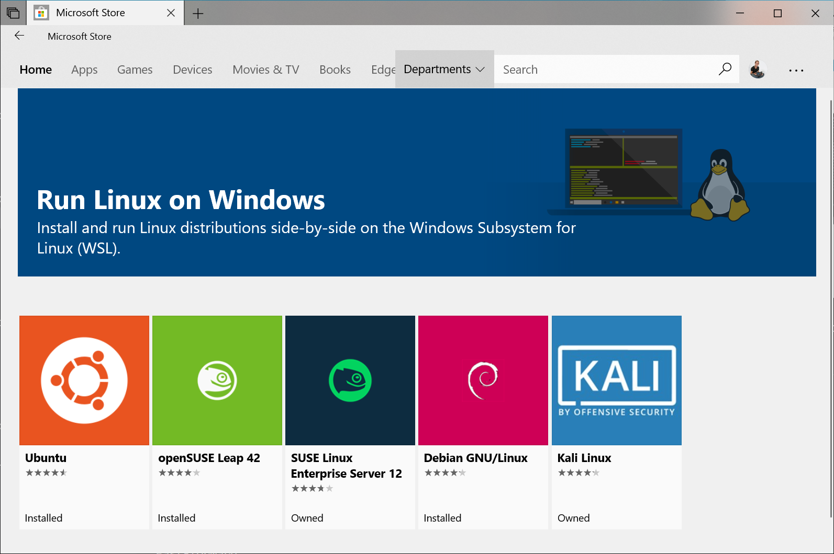
Install Linux distro from Windows Store

Slide 16
Manually Download Windows Store Distro APPX
If Widows Store access is not available, Distro APPX can be manually downloaded and installed from following path.
Store Distro Download Path:
Ubuntu 16.04: https://aka.ms/wsl-ubuntu-1604
Debian: https://aka.ms/wsl-debian-gnulinux
OpenSUSE Leap 42: https://aka.ms/wsl-opensuse-42
SUSE Linux Enterprise Server 12: https://aka.ms/wsl-sles-12Kali: https://aka.ms/wsl-kali-linux
Command to Download from Windows Terminal:
cmd.Exe
>bitsadmin /transfer myDownloadJob /download /priority normal https://aka.ms/wsl-ubuntu-1604 %USERPROFILE%\Downloads\Ubuntu_1604.appx
or
powershell.exe
>Invoke-WebRequest -Uri https://aka.ms/wsl-ubuntu-1604 -OutFile $env:userprofile\Downloads\Ubuntu_1604.appx -UseBasicParsing

Slide 17
Manage WSL Instance using wslconfig
Command | Description
WSLConfig | Performs administrative operations on Windows Subsystem for Linux
/l, /list [Option] | Lists registered distributions.
 | /all - Optionally list all distributions, including distributions that are currently being installed or uninstalled.
 | /running - List only distributions that are currently running.
/s, /setdefault <DistributionName> | Sets the distribution as the default.
/t, /terminate <DistributionName> | Terminates the distribution.
/u, /unregister <DistributionName> | Unregisters the distribution.
/upgrade <DistributionName> | Upgrades the distribution to the WslFs file system format.

Slide 18
Install GCC on WSL
1. Start by updating the packages list
$ sudo apt update
2. Install the build-essential package by typing
$ sudo apt install build-essential
3. Validate that the GCC compiler is successfully installed
$ gcc –version
4. Optionally Install gdb package by typing
$ sudo apt install gdb

Slide 19
Compiling Hello World Sample
1. Open Text Editor and create the source file
$ nano hello.c
#include <stdio.h>
int main()
{
printf ("Hello World!\n");
return 0;
}
Write (^O ) then exit (^X).
2. Compile using the following command
$ gcc hello.c -o hello
3. Execute the hello program
$ ./hello

Slide 20
Install/Uninstall SSH on WSL
1. Check the status of the ssh service:
$ service ssh status
sshd is running / * sshd is not running
2. Start ssh service:
$ sudo service ssh start
[sudo] password for mitu:
* Starting OpenBSD Secure Shell server sshd
Could not load host key: /etc/ssh/ssh_host_rsa_key
Could not load host key: /etc/ssh/ssh_host_dsa_key
Could not load host key: /etc/ssh/ssh_host_ecdsa_key
Could not load host key: /etc/ssh/ssh_host_ed25519_key
3. Stop ssh service:
$ sudo service ssh stop
* Stopping OpenBSD Secure Shell server sshd
4. Regenerate all the missing keys:
ssh-keygen: generating new host keys: RSA DSA ECDSA ED25519
5. Restart ssh service:
$ sudo service ssh --full-restart
* Stopping OpenBSD Secure Shell server sshd
* Starting OpenBSD Secure Shell server sshd
6. Remove/Install SSH.
$ sudo apt remove openssh-server
$ sudo apt update
$ sudo apt install openssh-server

Slide 21
Configuring SSH for Remote Debug
$ sudo nano /etc/ssh/sshd_config
Port 2225
PermitRootLogin no
AllowUsers <UserName>
UserPrivilegeSeparation no
PasswordAuthentication yes
Write (^O ) then exit (^X).
Then restart ssh server.

Slide 22
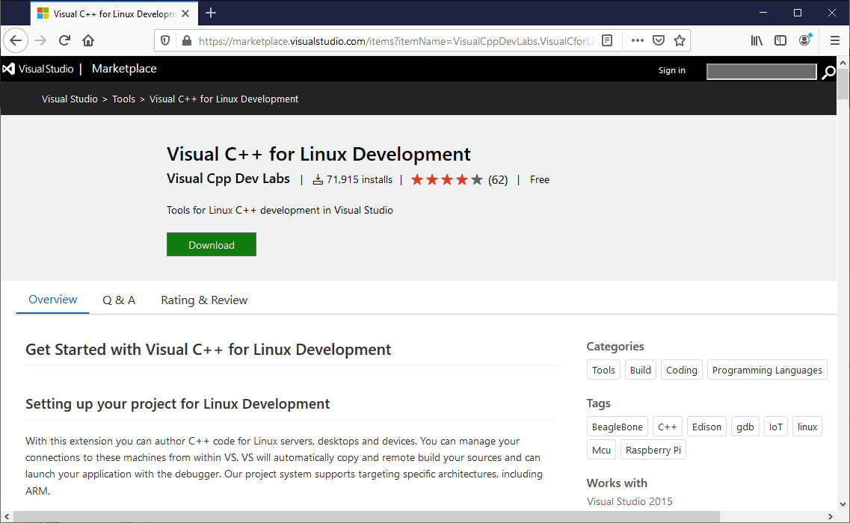
Install Visual C++ for Linux Development Extension

Slide 23
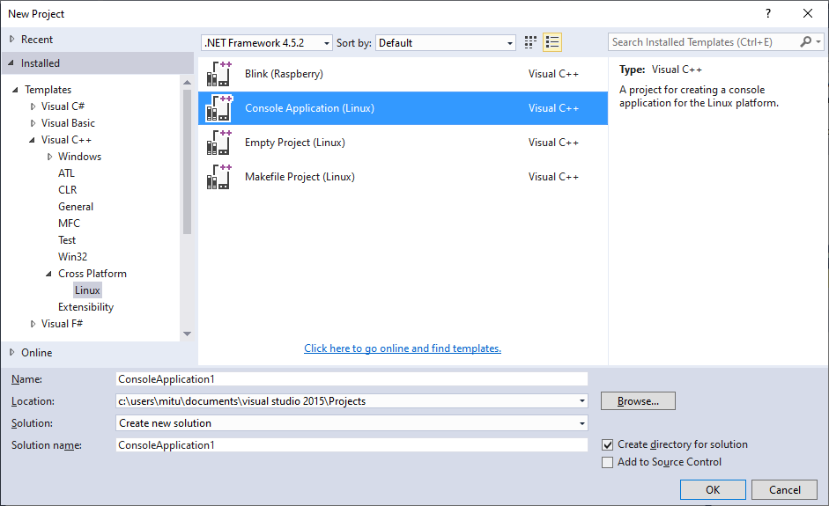
Creating a Linux Development Project

Slide 24
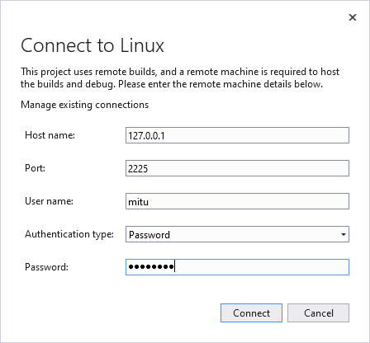
Connecting to WSL for remote compilation and debugging

Slide 25
Install .Net Core SDK on WSL
1. Add Microsoft repository key and feed
$ wget https://packages.microsoft.com/config/ubuntu/16.04/packages-microsoft-prod.deb -O packages-microsoft-prod.deb
$ sudo dpkg -i packages-microsoft-prod.deb
2. Install the .NET Core SDK
$ sudo apt-get update
$ sudo apt-get install apt-transport-https
$ sudo apt-get update
$ sudo apt-get install dotnet-sdk-2.1
3. Validate dotnet core installation
$ dotnet --version

Slide 26
Create HelloWorld Sample App
1. Create HelloWorld Console App Project
$ dotnet new console -o HelloWorld
2. Change to newly created folder HelloWorld and edit Program.cs
$ cd HelloWorld
$ nano Program.cs
using system;
namespace HelloWorld
{
class Program
{
static void Main(string[] args)
{
Console.WriteLine("Hello World!");
}
}
}
Write (^O ) then exit (^X).
3. Run HelloWorld App
$ dotnet run

Slide 27
References
https://docs.microsoft.com/en-us/archive/blogs/wsl/
https://docs.microsoft.com/en-us/windows/wsl/about
https://wiki.ubuntu.com/WSL
https://github.com/DDoSolitary/LxRunOffline
https://marketplace.visualstudio.com/items?itemName=VisualCppDevLabs.VisualCforLinuxDevelopment
https://docs.microsoft.com/en-us/dotnet/core/install/

Slide 28
END OF FILE

